Slide 1

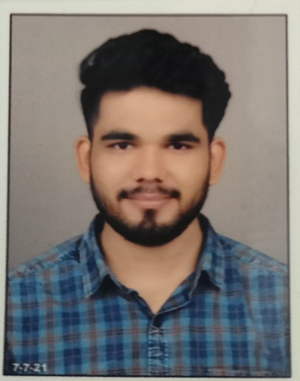
Mayur Donge
Education and certificates
Bachelor of Engineering- (2015-2019
Analyst/Software Engineer
Base Location: Mumbai
Skills
Basic JAVA
SQL
HTML
CSS
Email ID: mayur.donge@capgemini.com
_{Mobile No:} +919765599071
Grade:
A4
Database
SQL database – MySQL
No SQL database – MongoDB
Strengths
A self driven learner with Front-End and Back-End knowledge. Passionate about implementing and launching new projects.
Ready to learn new technologies/Frameworks and implement them to further improve my knowledge.
A team player with good communication skill always ready to work for the enrichment of knowledge.
Has working knowledge Java & SQL intermediate level.
Achivement
Online Wallet
Completed end to end case study of online wallet System
Creating application in MENDIX TOOL
Web Technologies
HTML
JavaScript
Coded and designed Static Web Pages
Additional Details
Communication Skills
Learn from basic things
Developed website with HTML5 and CSS3 Along Frameworks like SASS(Syntactically awesome style sheets) to make website more interactive and dynamic.
Check out my work on GitHub & Video Profile
Presentation Title | Author | Date © Capgemini 2017. All rights reserved | 1

